Slide 1
Properties of
Regular Languages

Slide 2




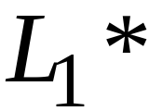
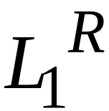


For regular languages and
we will prove that:
Union:
Concatenation:
Are regular
Languages
Star:
Reversal:
Complement:
Intersection:

Slide 3
We say: Regular languages are closed under
Union:
Concatenation:
Star:
Reversal:
Complement:
Intersection:

Slide 4



A useful transformation: use one accept state
NFA
2 accept states
Equivalent
NFA
1 accept state

Slide 5
In General
NFA
Equivalent NFA
Single
accepting
state

Slide 6
Extreme case
NFA without accepting state
Add an accepting state
without transitions

Slide 7
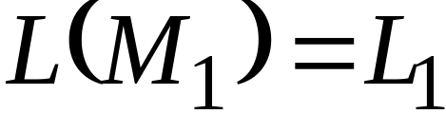
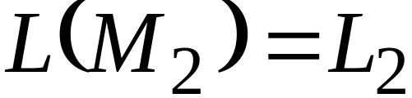


Take two languages
Regular language
Regular language
NFA
NFA
Single accepting state
Single accepting state

Slide 8

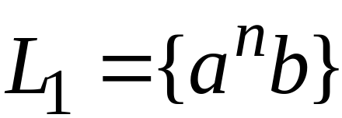
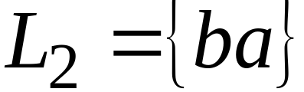
Example

Slide 9
Union
NFA for

Slide 10
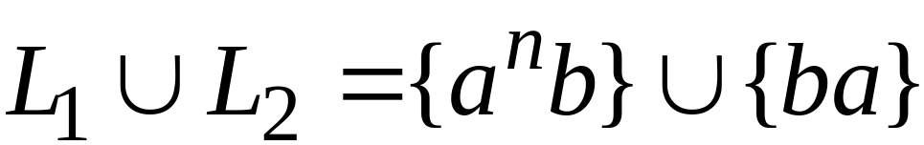
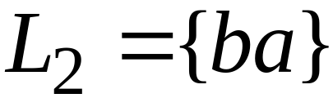
Example
NFA for

Slide 11
Concatenation
NFA for

Slide 12
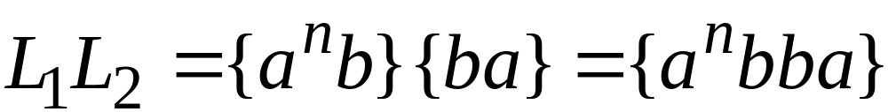
Example
NFA for

Slide 13
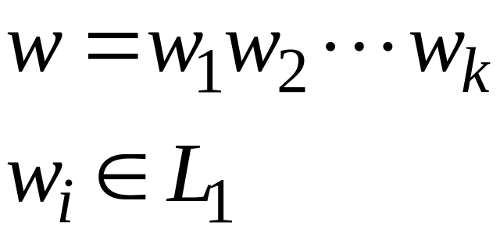
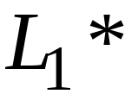
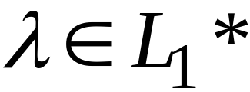
Star Operation
NFA for

Slide 14
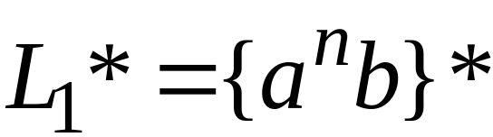
Example
NFA for

Slide 15

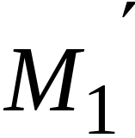
Reverse
NFA for
1. Reverse all transitions
2. Make initial state accepting state
and vice versa

Slide 16
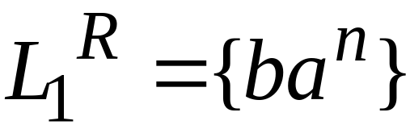
Example

Slide 17
Complement
1. Take the DFA that accepts
2. Make accepting states non-final,
and vice-versa

Slide 18

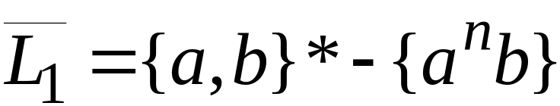
Example

Slide 19
Intersection
regular
We show
regular
regular

Slide 20




DeMorgan’s Law:
regular
regular
regular
regular
regular

Slide 21
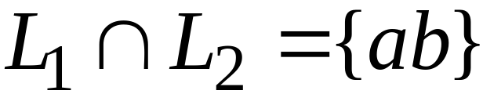
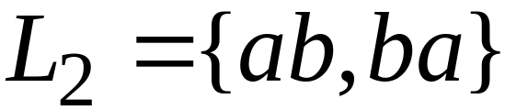
Example
regular
regular
regular

Slide 22

Another Proof for Intersection Closure
Machine
Machine
DFA
for
DFA
for
Construct a new DFA that accepts
simulates in parallel and

Slide 23

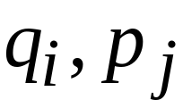
States in
State in
State in

Slide 24




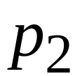
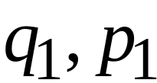
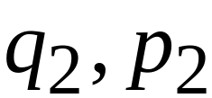
DFA
DFA
transition
transition
DFA
New transition

Slide 25

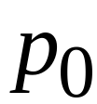
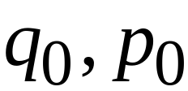
DFA
DFA
initial state
initial state
DFA
New initial state

Slide 26



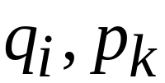
DFA
DFA
accept state
accept states
DFA
New accept states
Both constituents must be accepting states

Slide 27

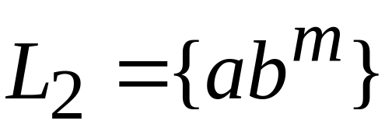








Example:

Slide 28
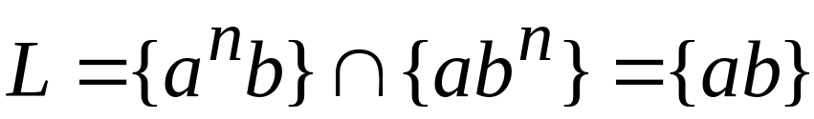







Automaton for intersection

Slide 29


simulates in parallel and
accepts string
if and only if:
accepts string
and accepts string

